Slide 1

Exit Exam Application
Team G
Garrett Johnson Jose Soto
Chris Anthony Sandesh Pathak

Slide 2
Introduction & Roles
Customer: Dr. Catherine Stringfellow
Team G short for Team Garrett or Team Gear
Garrett Johnson- Project Lead/UI Designer/Frontend Programmer
Jose Soto- Backend Programmer
Chris Anthony- Test Data Developer/Documentation Manager
Sandesh Pathak- Test Data Developer/Recorder

Slide 3
Overview
Problem Statement
System Design & Tools
Process Model
Test Report
Problems and Issues
Demo
More Time?
Do Over?
What did we learn?

Slide 4
Problem Statement
Create a standalone desktop application to simulate the Computer Science Exit Exam

Slide 5
System Requirements
1 GHz 32-bit (x86) or 64-bit (x64) CPU
1 GB of RAM
128 MB of graphics memory
2 GB of storage

Slide 6
Tools
VSCode (Frontend)
Replit (Backend)
Github (Repo & Issue Tracker)
Python 3.10
Kivy 2.10 (GUI)
Draw.io (Designs and Diagrams)
Discord (Communication)
Slack (Switched to Discord halfway through)

Slide 7
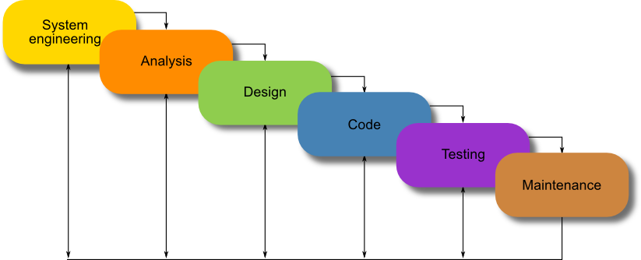
Process Model
Waterfall Process
With Scrum Elements
This Photo by Unknown Author is licensed under CC BY

Slide 8
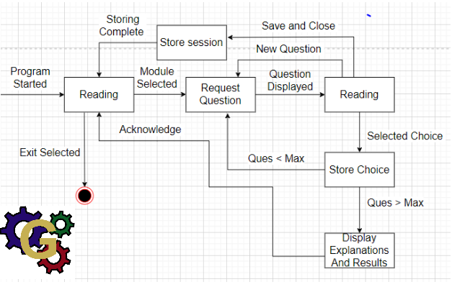
State Diagram

Slide 9
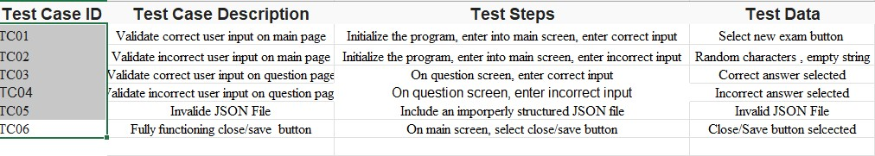
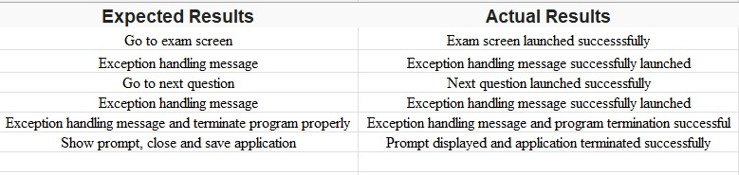
Test Report

Slide 10
Problems and Issues
With the Team
Availability
Communication
Time Management
Inexperience with Frontend development
With the Application
Backend deleted data from JSON file
Duplicate questions
Python GUI Language
UI Design
Tool failure

Slide 11
Demo

Slide 12
More Time?
Frontend
Add load screens in between screen transitions
Ability to export results to a file
Add a hint button
Allow multiple save files
Backend
Add a managing system to add and edit question
Provide in depth statistics on practice test section
Add an image storage system for questions

Slide 13

Start Over?
Get solid requirements and better documentation
Different Schema for the Backend
Use KivyMD to make the project GUI better looking
Turn the project into a Web Application that uses React or Electron
Use a database to store the information

Slide 14
What did we learn? (Garrett)
Garrett
In-depth explanation of OOP concepts for Python
Create a GUI using only Python libraries
Communication between Frontend and Backend
Application Packaging
Software Development is difficult to manage
Communication is key

Slide 15
What did we learn? (Jose)
I learned how to interact with JSON and how to parse into python objects
I improved on my python skills
I learned how the design process helps generate requirements questioning

Slide 16
What did we learn? (Chris)
How to communicate and collaborate better with a team
I learnt as well as familiarized myself more with the python language, JSON files, the python library known as Kivy and lucid chart which was used to create several of our group's diagrams
I also learnt that not everything works out as planned and that deadlines are very important.

Slide 17
What did we learn? (Sandesh)
GUI using python libraries
Team collaboration and communication
KIVY in general
Gaining experience to make an app

Slide 18

Questions

